Slide 1
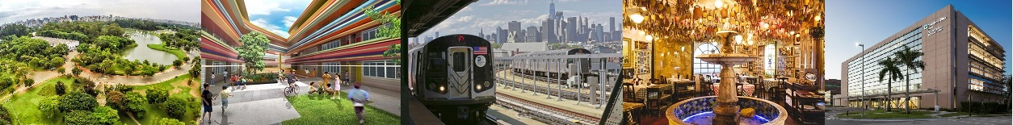
Finding a good neighborhood in New York City

Slide 2
Why a suitable neighborhood is important
Higher Work Productivity
More Emotional Estability
Improved Family Welfare
Higher Personal and Familiar Happiness

Slide 3
Our Mission
Find neighborhoods in New York City that might be of interest of someone moving to this city

Slide 4
Potential Stakeholders
Public Offices in Change of Establishment of:
  Immigrants
  Refugees
Private Businesses
  Real State Companies
  Global Corporations

Slide 5
Data Acquisition and Cleaning
Borough and neighborhood data provided by Coursera
  https://cocl.us/new_york_dataset
Foursquare category data provided by Foursquare
  https://api.foursquare.com/v2/venues/categories
Venues data provided by Foursquare API
  https://api.foursquare.com/v2/venues/search
Parameters (categories and priorities) informed by user

Slide 6
Data Acquisition and Cleaning
5 available Boroughs
306 available Neighborhoods
457 available categories for user selection, so far
Categories non specified by user were dropped
Number of final features depends on the user’s choices
Number of final neighborhoods dependes on the user’s choices

Slide 7
Premises for This Presentation
In this presentation, we are considering the same example found in Jupyter Notebook and Full Report
  The tool searches for a suitable solution for each case, NOT a closed one-size-fits-all solution
Categories
Category | Importance | Category | Importance
Fruit & Vegetable Store | 3 | Market | 3
Laundry Service | 2 | Drugstore | 1
Athletics & Sports | 2 | Metro Station | 2
Bus Stop | 2 | Pharmacy | 1
Italian Restaurant | 2 | Pizza Place | 2

Slide 8
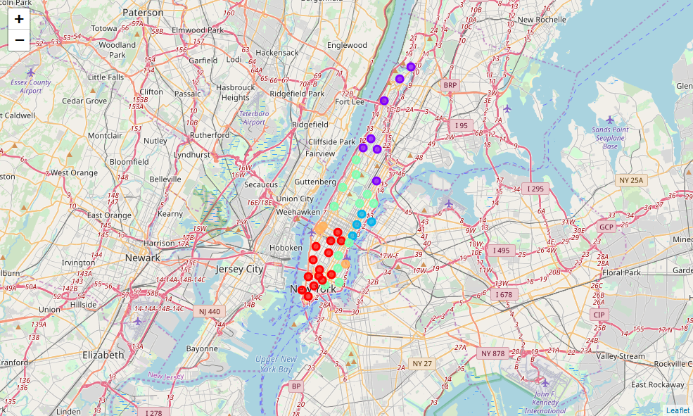
KMeans Clusters
Only Manhattan area
Prevalences by color
Metro Stations
Bus Stops
Fruit and Vegetable stores
Italian restaurants
Markets

Slide 9
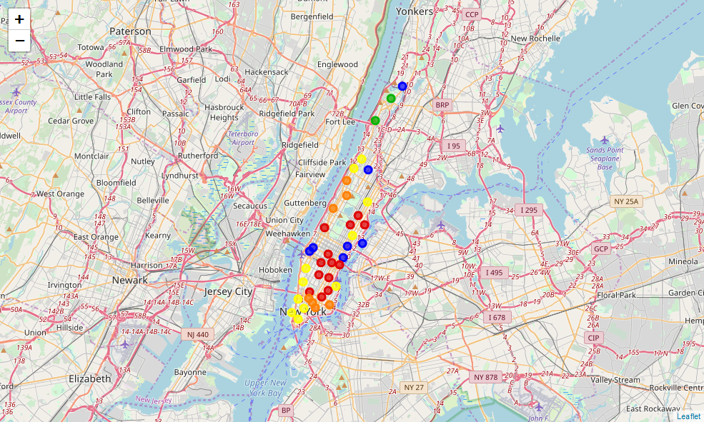
Ratings
Only Manhattan area
Color Meaning
Very bad place
Bad place
Regular place
Good place
Very good place

Slide 10
Conclusion and Future Improvements
A very flexible tool to help people moving to New York City has been developed
Easy to adapt for other metropolitan area
Future enhancements includes:
  Criminal data
  Real state indicators per neighborhood data
  Demographics data

